Slide 1
Week - 6
Presented by:
Shafin Bin Hamid
Lecturer
Department of Electrical and Electronics Engineering
Bangladesh University of Engineering and Technology

Slide 2
Outline
Nodal analysis
Mesh analysis
Superposition
Source Transformation
Thevenin equivalent circuit
Power in AC circuit
Maximum average power transfer
Effective/RMS value

Slide 3

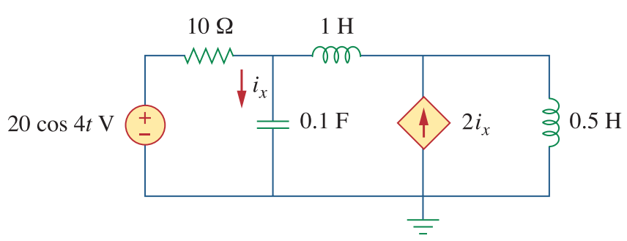
Nodal analysis

Slide 4
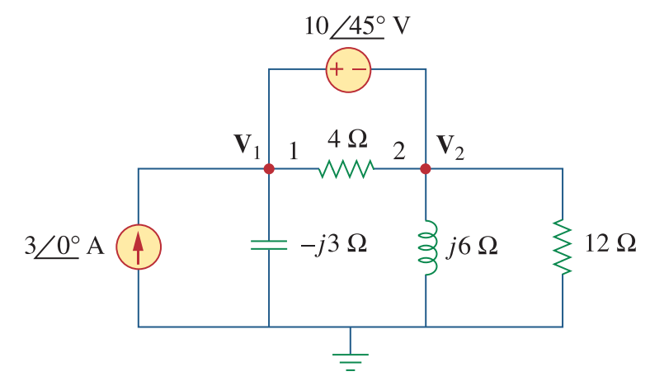
Nodal analysis

Slide 5
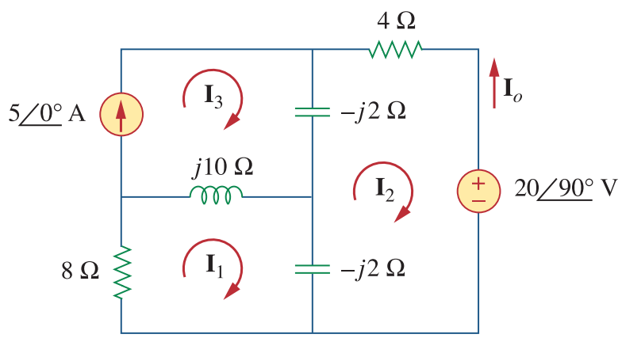
Mesh analysis

Slide 6
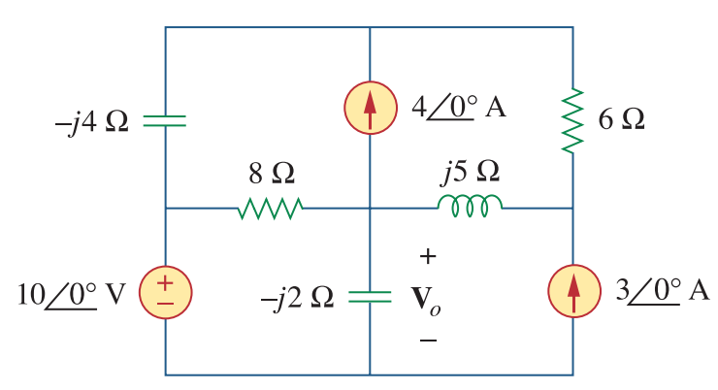
Mesh analysis

Slide 7
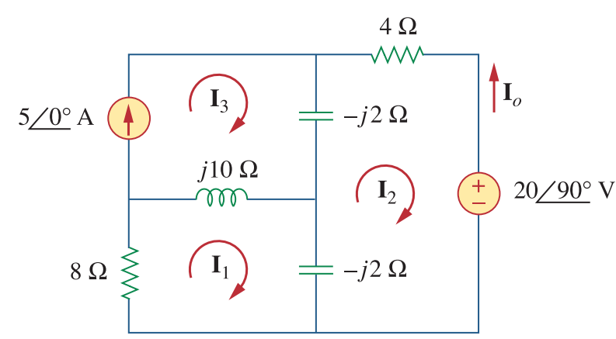
Superposition

Slide 8

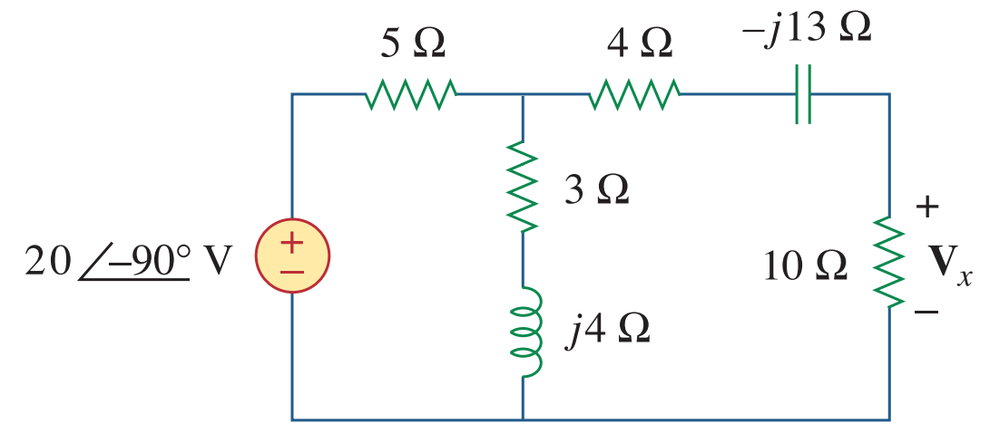
Source Transformation

Slide 9
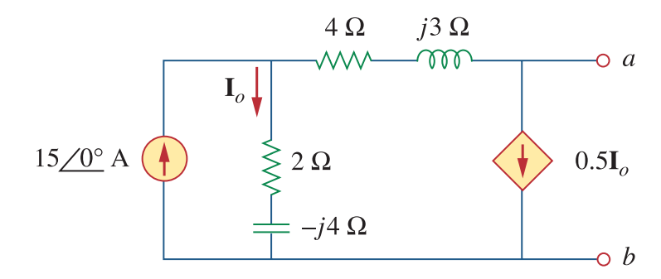
Thevenin equivalent circuit

Slide 10
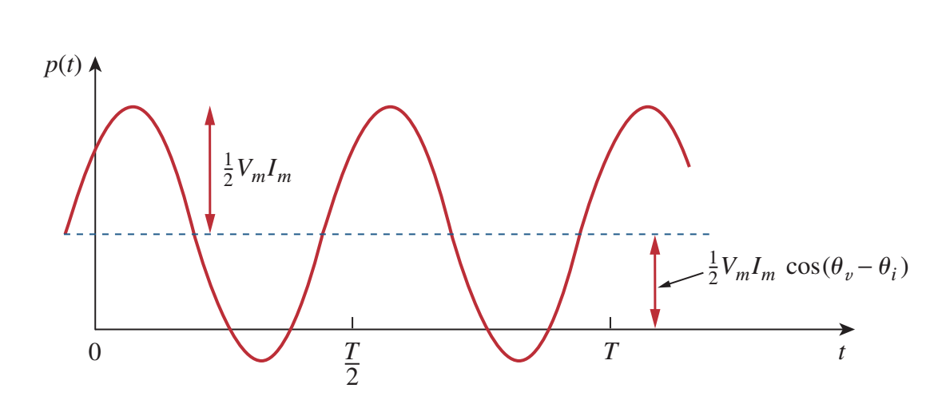
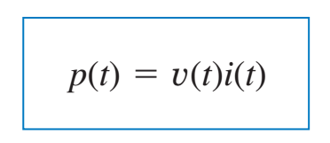
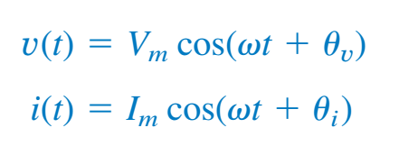

Power in AC circuit

Slide 11
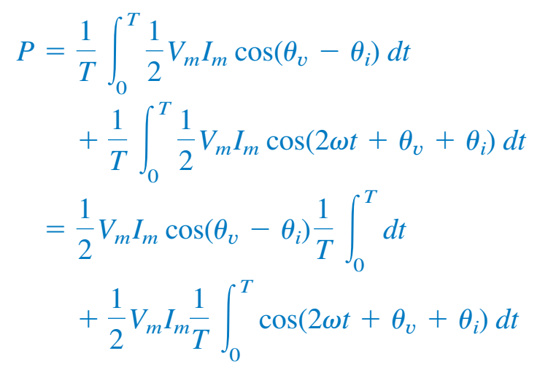
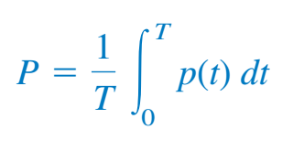

Average power

Slide 12
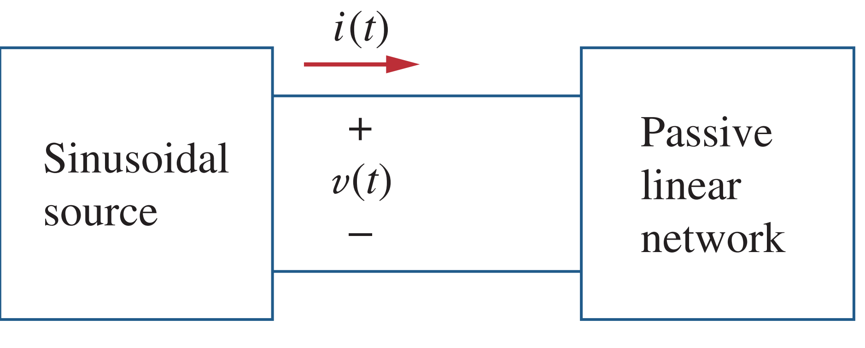

Problem

Slide 13

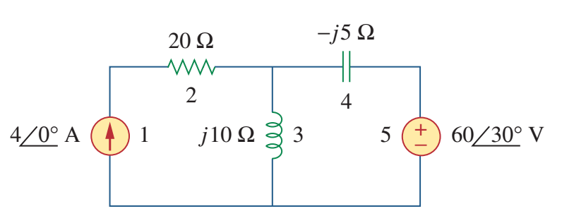
Problem

Slide 14
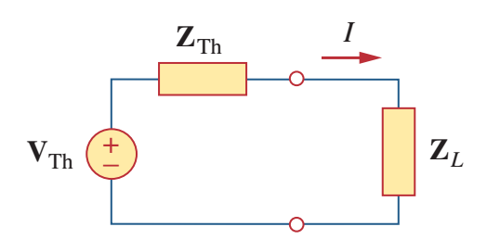



Maximum average power transfer

Slide 15


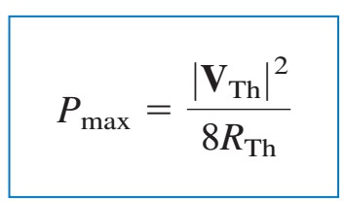
Maximum average power transfer

Slide 16

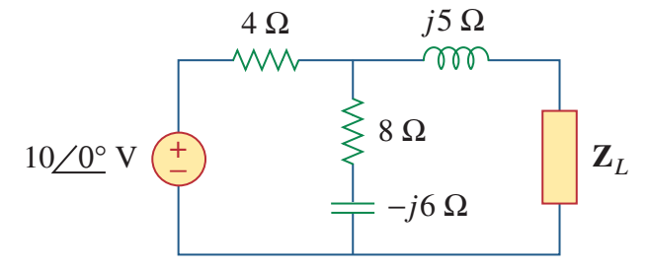
Problem

Slide 17

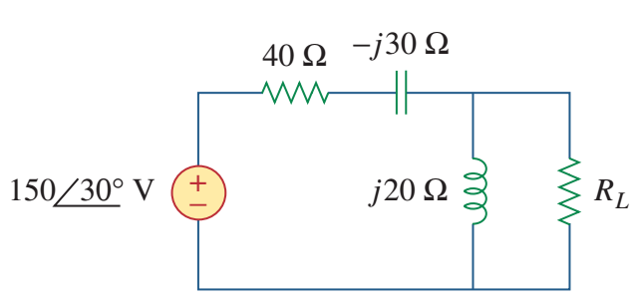
Problem

Slide 18

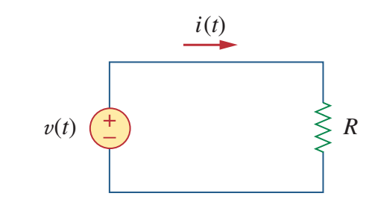


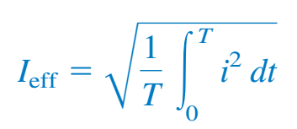
Effective/RMS Value

Slide 19
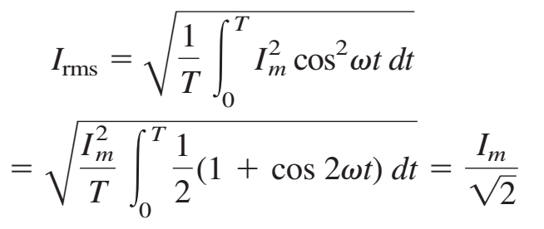

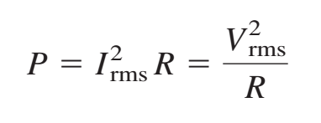
Effective/RMS Value

Slide 20

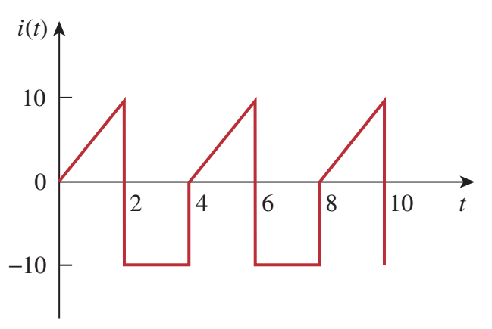
Problem

Slide 21

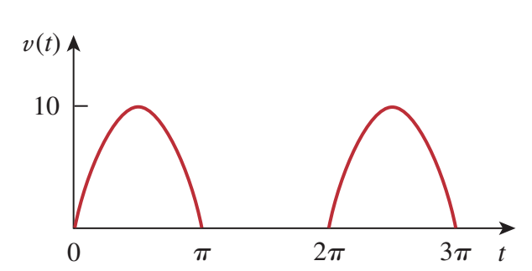
Problem

Slide 22


